Slide 1
FORMATIVE ASSESSMENT
Digital Design – Game Design
Joseph Yu

Slide 2
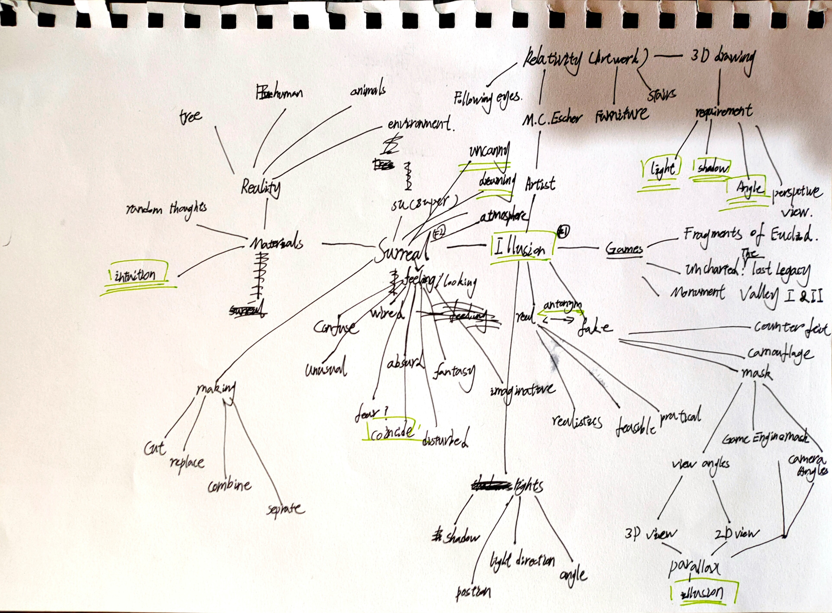
5 keywords-surreal
Surreal
Environmental visual design
Creating environments using surreal elements
Different interpretations by individuals connect the surreal to illusion
Using this as a denial
Surreal： illusion-angles-dream like-uncanny- coincidence

Slide 3
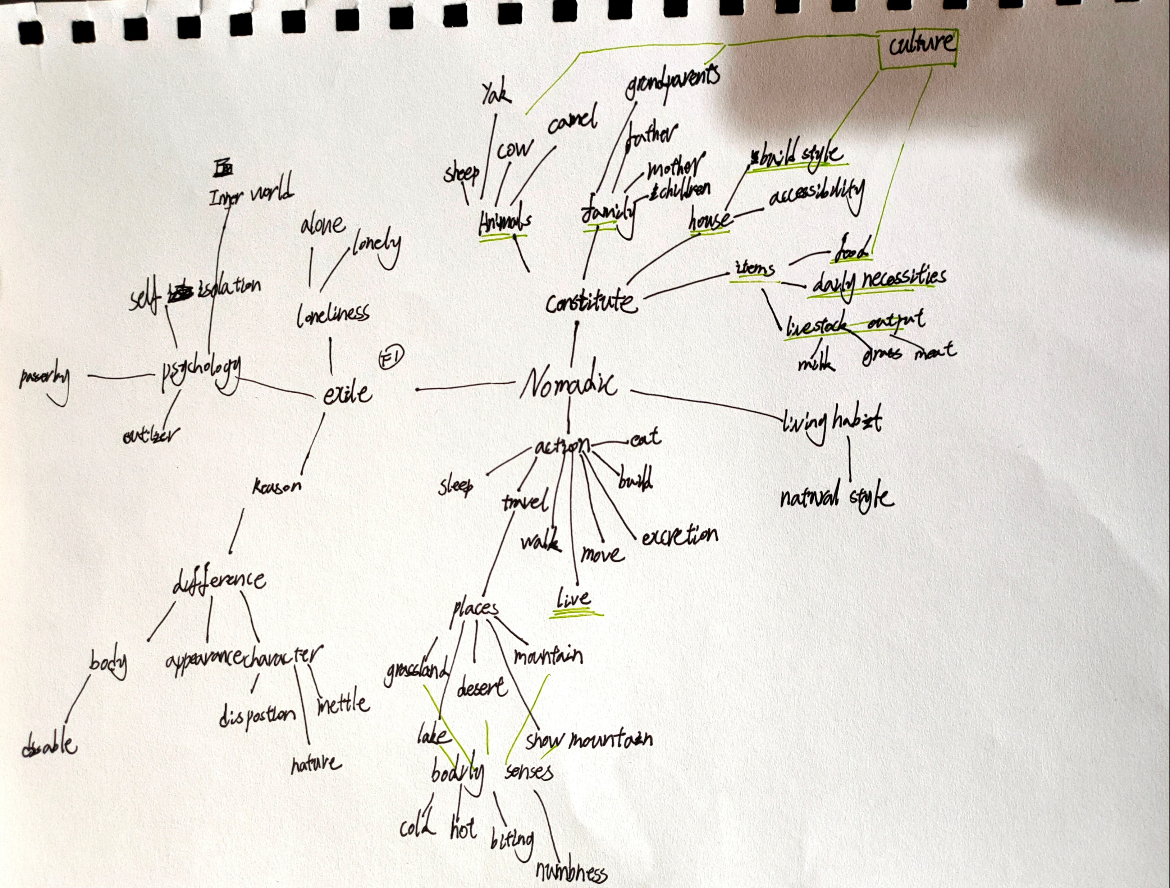
5 keywords-Nomadic
Exile
Self-isolation
Storytelling
Background
Character outfit
Nomadic：self isolation – lonely - psychology -difference – culture

Slide 4
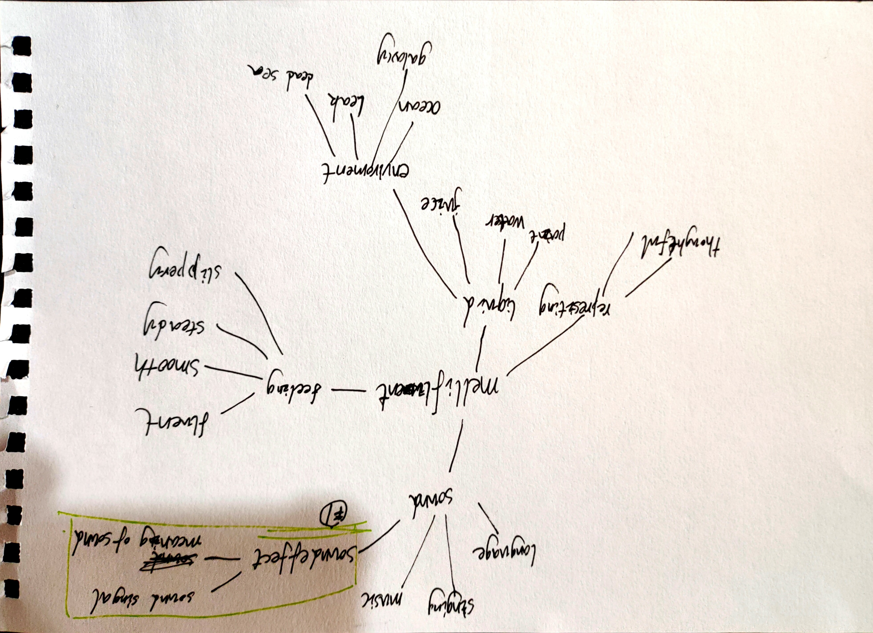
5 keywords-Mellifluent
Sound
Sound signal
Sound representing
Sound usage of environmental design.
Enhances gameplay relative with sound
Mellifluent: sound – representing - sound signal – meaning of sound

Slide 5
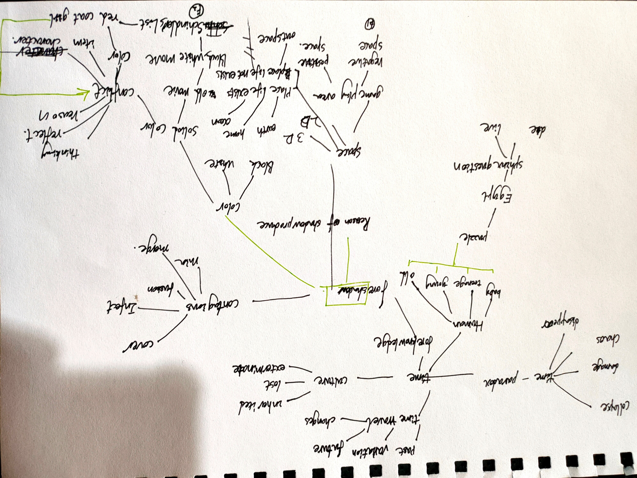
5 keywords-Foreshadow
Time
Shadow/ light
Solid colour
Color meaning
Foreshadow: shadow – colors -solid color - metaphor

Slide 6
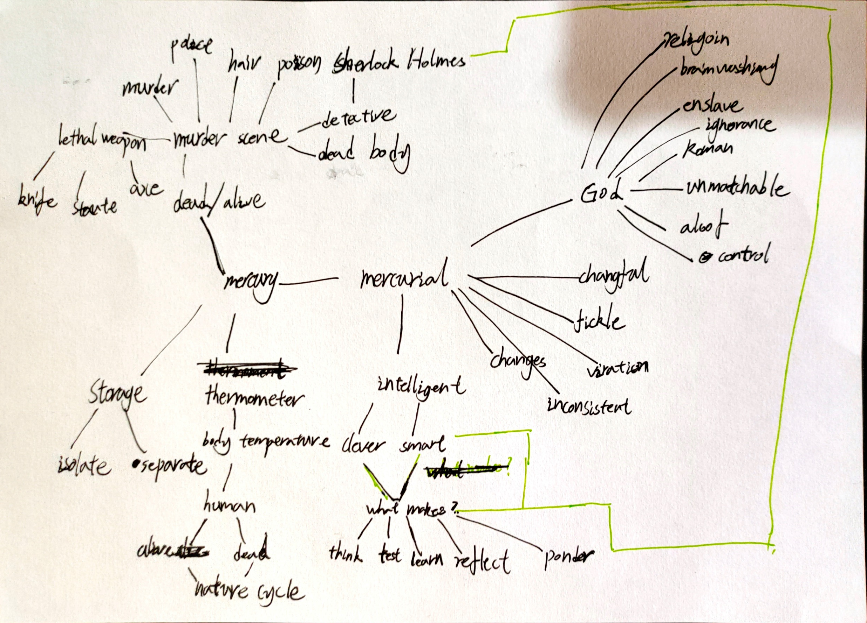
5 keywords-Mercurial
Mercurial
What makes people thinking
Mercurial: changeful – intelligent – thinking

Slide 7
Exploration
Mellifluent: sound – representing - sound signal – meaning of sound
Sounds of environment
Sounds of interactive with objects
Sounds of something in progress

Slide 8
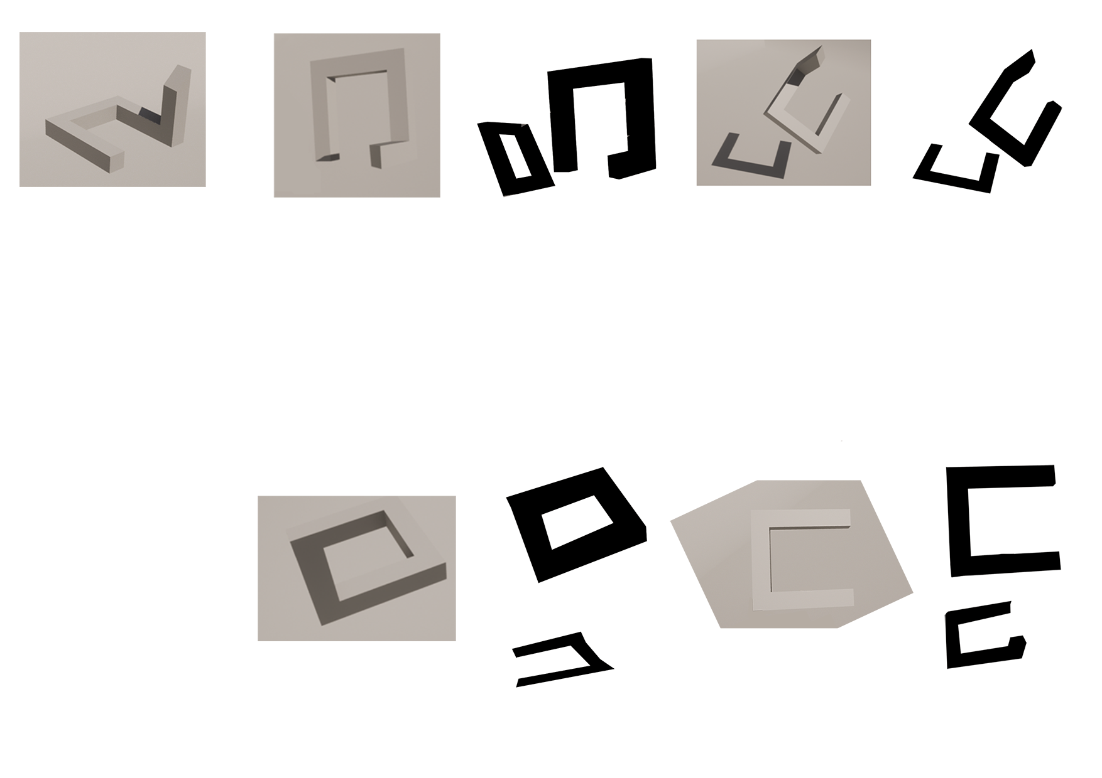
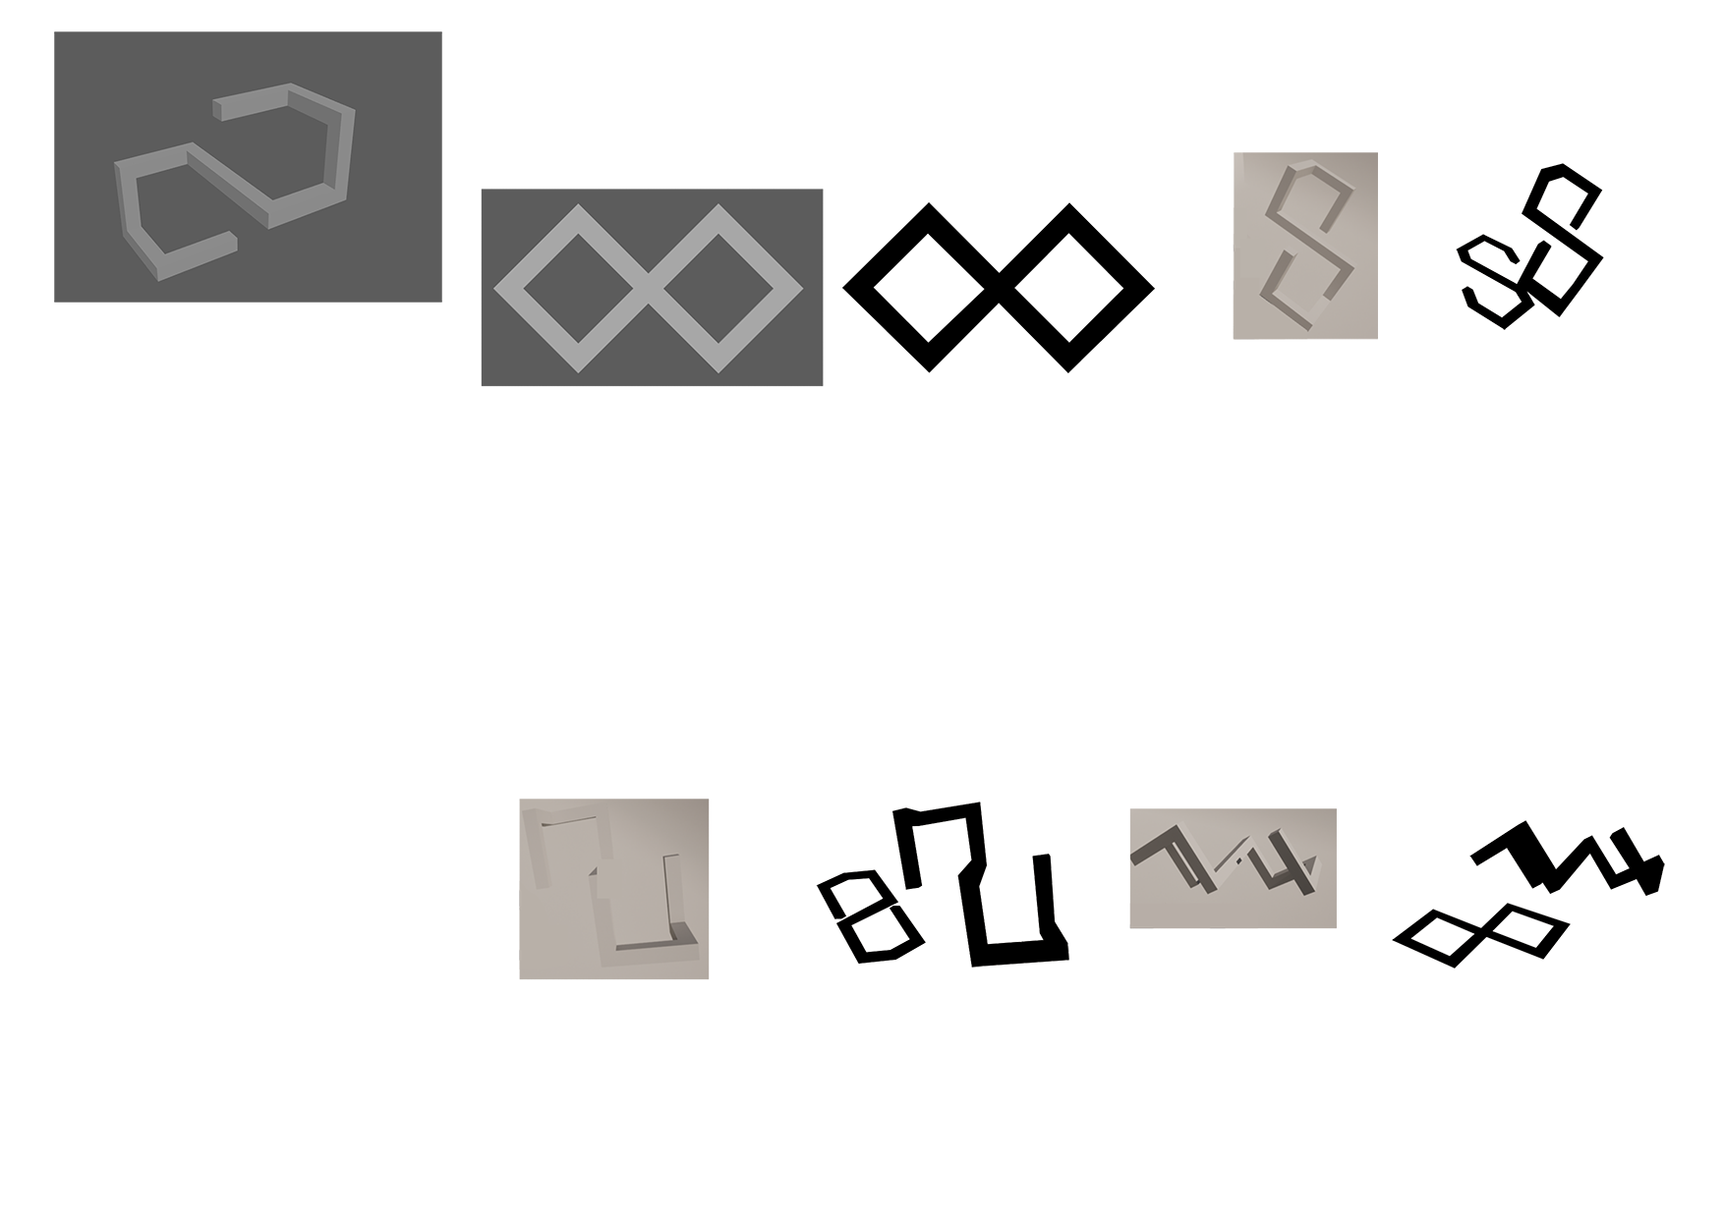
Explorations
Surreal - Foreshadow- Mercurial
illusion-angles X shadow -solid color - metaphor X changeful – intelligent – thinking

Slide 9
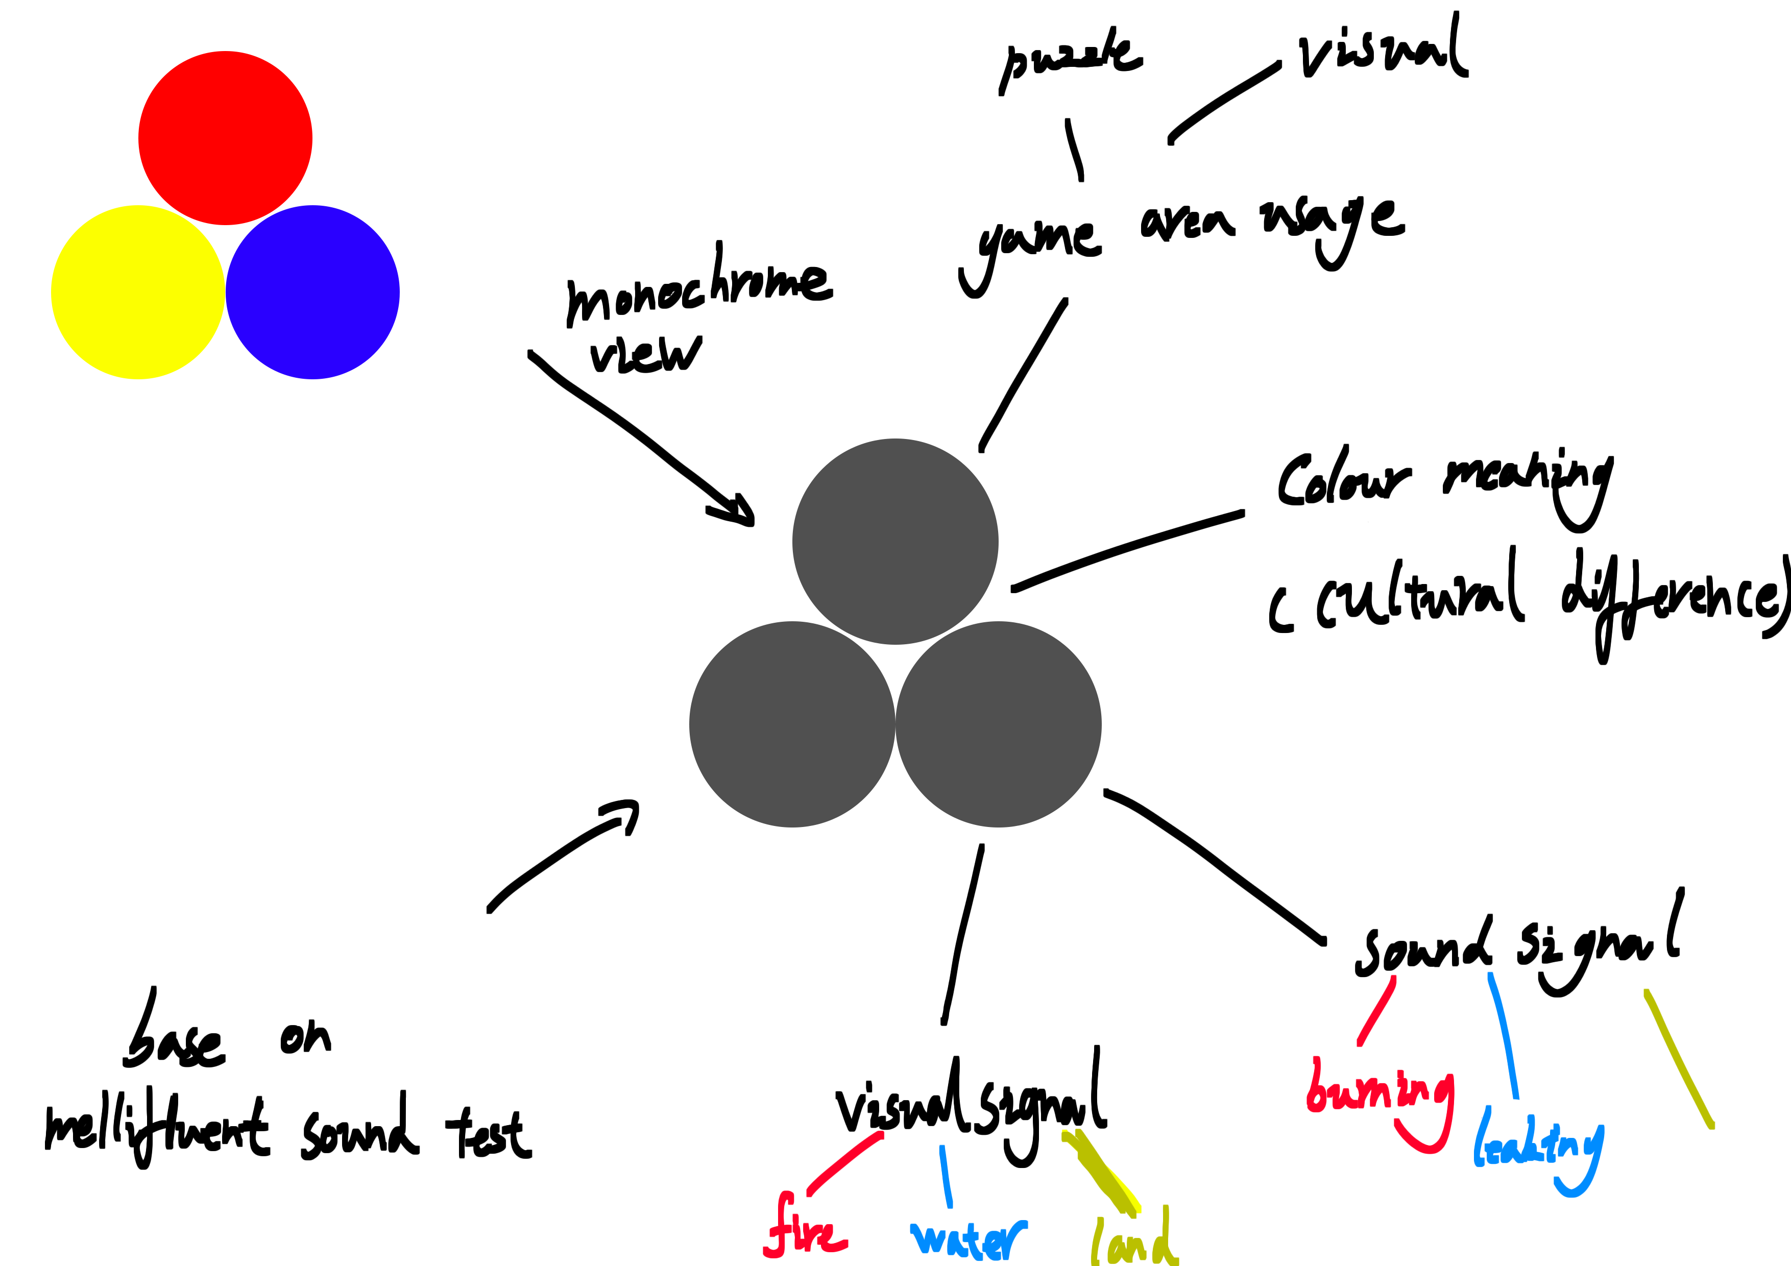
Further Explorations
Mellifluent – Nomadic- Foreshadow- Mercurial-Surreal
In the second week's class feedback, Sue wondered how colour-blind people interpret coloured warning areas in weather forecasts. This topic inspired me to incorporate this colour-blind perspective into game design progress and combine keywords such as mellifluent, foreshadow, nomadic, and Mercurial to think about how to express colours other than black and white in a monochrome view.
I plan to use visual signal (surreal) and sound signal (Sound) to express a different way of showing colours in a monochrome view. I will only do tests on the primary colours (solid colours) and explore the possibility of applying this expression method to gameplay.

